Slide 1
Personality
Renee El-Krab, MS (She/her)
relkrab@ric.edu

Slide 2
Personality
a pattern of enduring distinctive thoughts, emotions, and behaviors that characterize the way an individual adapts to the world

Slide 3
Psychodynamic Perspectives
Theoretical view emphasizing that personality is primarily unconscious (beyond awareness).
Understanding personality involves exploring the symbolic meanings of behavior and the unconscious mind
Early childhood experiences sculpt the individual’s personality
Who is the best known psychodynamic theorist?

Slide 4
Psychodynamic Perspective
Freud and Psychoanalysis
sex drive – main determinant of personality development
Hysteria
physical symptoms without physical cause
overdetermined – multiple unconscious causes
Usually diagnosed in women
“wandering uterus”
Taken out of the DSM in 1980

Slide 5
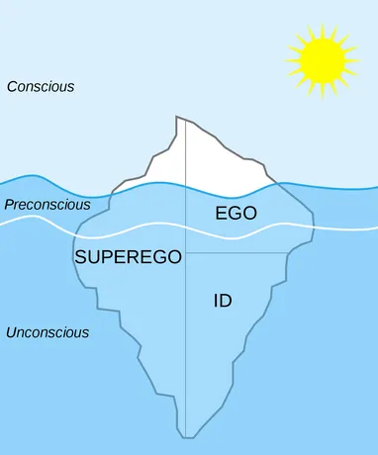
Freud’s Personality Structures
01
02
03
Id
instincts and reservoir of psychic energy
pleasure principle
Ego
deals with the demands of reality
reality principle
Resolves conflict between Id and Superego
Superego
moral branch of personality; “conscience”
Restrains the Id

Slide 6
Freud’s Personality Structures
If you were considering doing something that would be fun but is also considered immoral, which part would …
be in favor of doing it?
be against doing it?
resolve the conflict between those perspectives?

Slide 7
Defense Mechanisms
Conflict between the id, ego, and superego results in anxiety.
Sometimes we reduce anxiety using coping mechanisms
Repression | Ego pushes unacceptable impulses out of the conscious mind
Rationalization | Ego replaces unacceptable motive with a more acceptable one
Displacement | Ego shift feelings from unacceptable object to new object
Sublimation | Ego replaces unacceptable impulse with a more acceptable one
Projection | Ego attributes shortcomings to others
Reaction Formation | Ego transforms unacceptable motive into its opposite
Denial | Ego refuses to acknowledge anxiety-producing realities
Regression | Ego seeks the security of an earlier developmental period

Slide 8


Limitations to Freud’s Perspective
Sexuality
Early Experience
Consciousness
Not a pervasive force behind personality
Plays a small role – not as much as Freud thought
Does not consider the role of conscious thoughts and decision making

Slide 9
Other Psychodynamic Perspectives
Horney’s Sociocultural Approach
both sexes envy the attributes of the other
need for security, not sex, is primary motivator
Jung’s Analytical Theory
collective unconscious and archetypes
Adler’s Individual Psychology
perfection, not pleasure, is key motivator

Slide 10
Evaluating Psychodynamic Theory
Criticisms
Contributions
little acknowledgement of impact of current experiences
too much faith in unconscious mind’s control
too much emphasis on sexual instincts
importance of childhood experiences
development proceeds in stages
we transform and give meaning to our experiences
role of unconscious processes

Slide 11
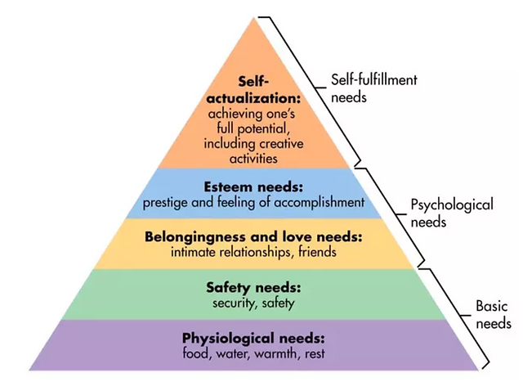
Humanistic Perspectives
Focus on capacity for growth
Given the appropriate environment, all people can be fulfilled
Positive Human Qualities
Abraham Maslow
Self-actualization
Peak experiences
Biased since focus was on highly successful individuals

Slide 12
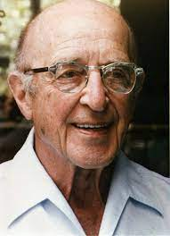
Humanistic Perspectives
Carl Rogers
Argues that we have innate tendencies toward growth and fulfillment.
Unhappiness occurs when we don’t have…
Unconditional Positive Regard: An individual’s need to feel accepted, valued, and treated positively regardless of their behavior
Conditions of Worth: The standards that one must live up to in order to receive positive regard from others

Slide 13
Promoting Optimal Functioning
Unconditional Positive Regard
Feeling unconditionally accepted & valued
Empathy
Interacting with people who are empathetic
Good listener; understanding
Genuineness
Being our authentic selves
3 Essential Qualities

Slide 14
Evaluating Humanistic Perspectives
Criticisms
Contributions
too optimistic about human nature
does not hold people accountable for negative behaviors
self-perception is key to personality
consider the positive aspects of human nature
emphasize conscious experience

Slide 15
Trait Perspectives
Trait:
an enduring disposition that leads to characteristic responses
traits are the building blocks of personality
Note: Trait theory stands in contrast to personality theorists who claim that the whole is greater than the some of its parts.
While trait theorists claim that a personality can be understood by listing off the traits that go into that personality, critics insist that a tiger is more than a pile of tiger parts, and a personality is more than a pile of traits.

Slide 16
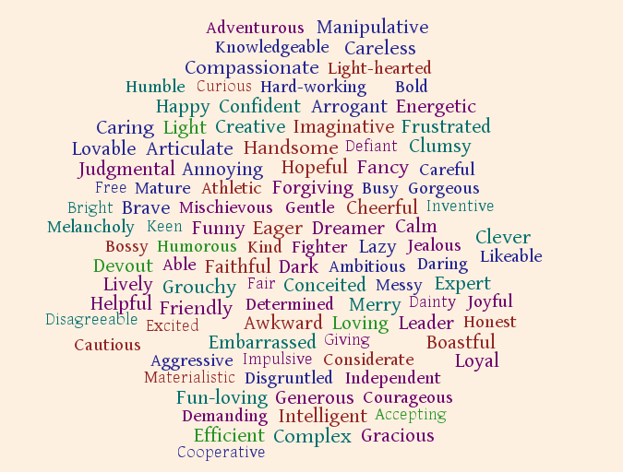

Slide 17
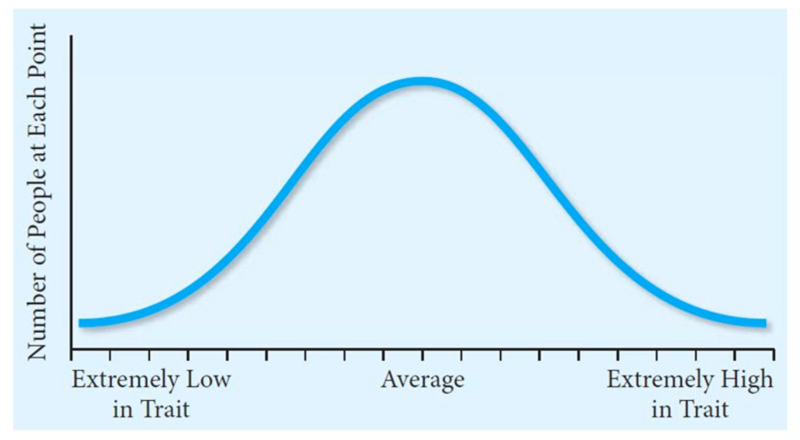
Trait Perspectives
Traits- Personality tendencies that endure over time
Emphasize describing personality over looking at how it develops
Traits are on a continuum

Slide 18
Which Traits Matter?
Lexical approach
If something is important to us, it should be reflected in our language
Factor Analysis
Identify related items
The more important a trait is, the more likely it will be represented by one word
If someone were to score a 5 on outgoing, they would probably score a 5 on talkative and a 1 on shy
Gordon Allport developed…

Slide 19
Trait Perspectives
Costa and McCrae
Five factor model (“The Big 5”)
Each factor is bipolar
Each has “facets”
Each is normally distributed

Slide 20
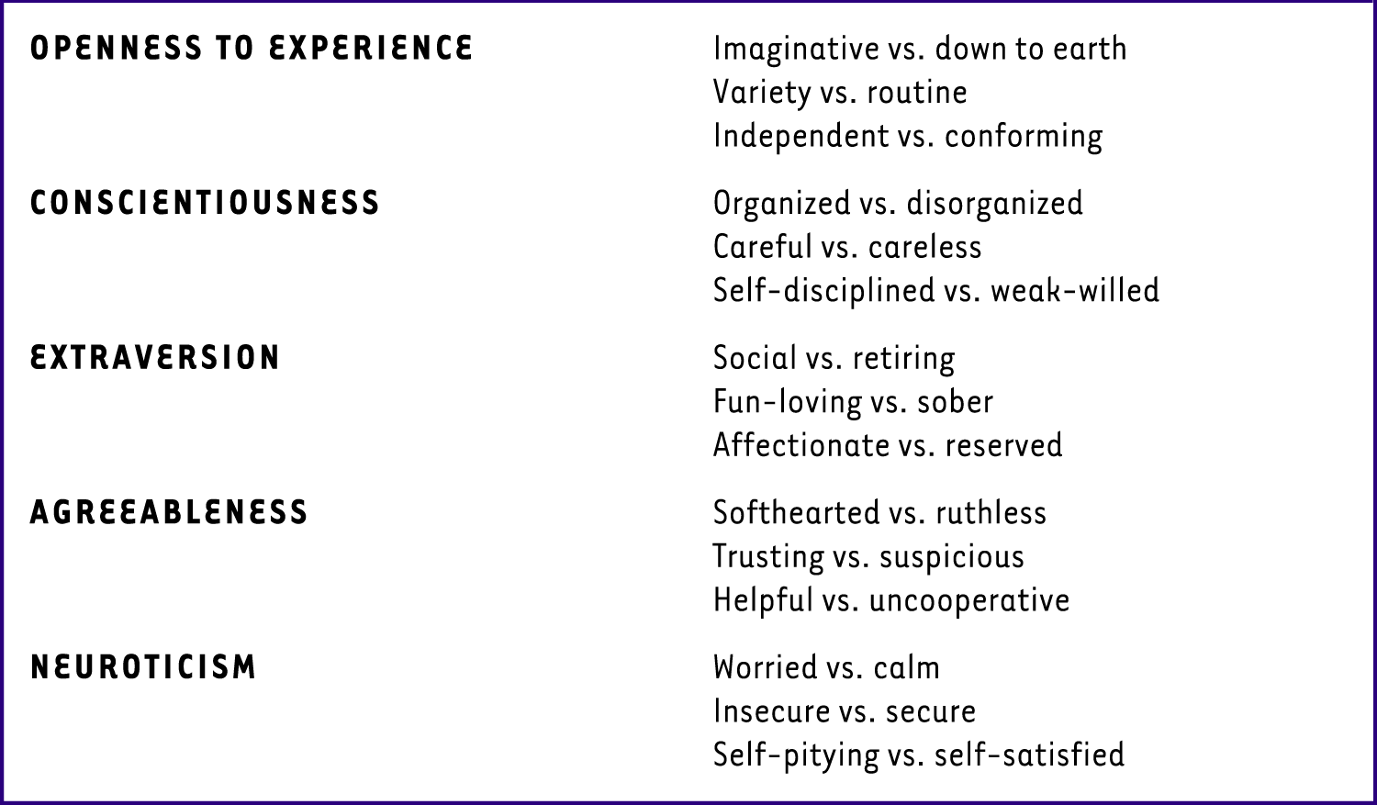
5 Factor Model: OCEAN

Slide 21
Across Cultures
Do the big five show up in the assessment of personality in cultures around the world?
Yes, especially extraversion, agreeableness and conscientiousness

Slide 22
Evaluating Trait Perspectives
Criticisms
Contributions
Ignores the role of the situation in behavior
Ignores nuances of an individual’s personality
traits influence health, cognitions, career success, and interpersonal relations

Slide 23
Quiz
Take out a paper
Put your name at the top

Slide 24
1. What is one criticism of Trait Perspectives?
Ignores the role of the situation in behavior
Too optimistic about human nature
Does not hold people accountable for negative behaviors
Too much faith in unconscious mind’s control

Slide 25
2. Which of Freud’s personality structures deals with the demands of reality?
Id
Ego
Superego

Slide 26
Which characteristic in the 5 Factor Model compares people on organization and carefulness?
Conscientiousness
Extraversion
Agreeableness
Neuroticism

Slide 27
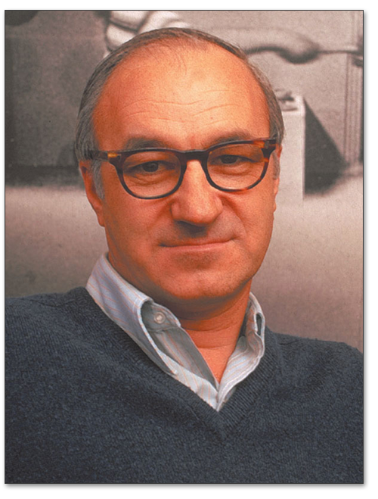
Social Cognitive Perspective
Emphasis is on conscious awareness, beliefs, expectations, and goals.
Incorporates principles from behaviorism when exploring:
reasoning
beliefs
self reflection
interpretation of situation

Slide 28
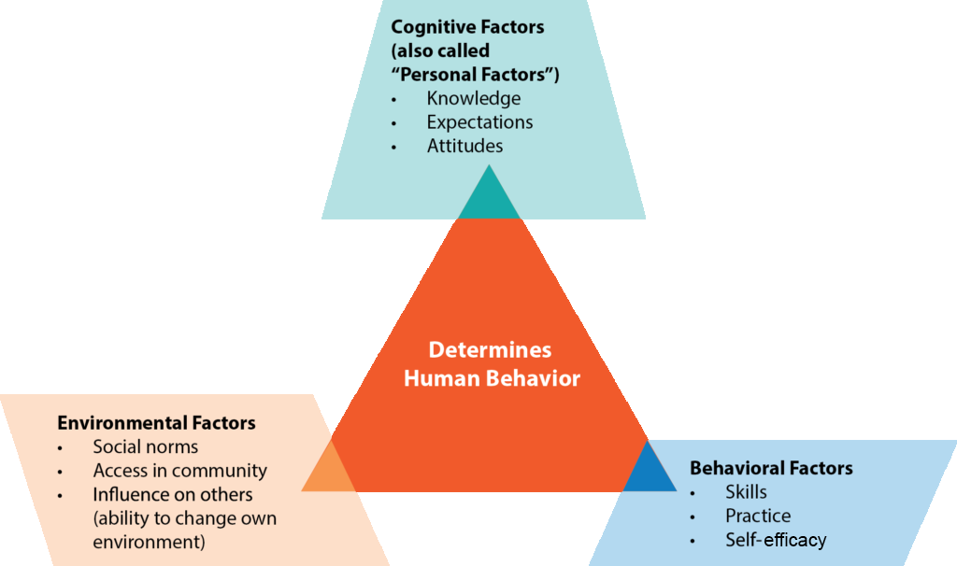

Slide 29
Social Cognition Perspective
Locus of Control
Internal vs External
What is controlling my choices and behaviors?
Self-Efficacy: the belief that one can master a situation and produce positive change
Which do you think is better?
“I can determine my future”
“Why do these things happen to me”
“I can make things happen”
“There’s nothing I can do about it”

Slide 30
Evaluating Social Cognition Perspectives
Criticisms
Contributions
too concerned with change and the situation
ignores the role of biology
very specific predictions hinder generalization
focuses on interactions of individuals with their environments
suggests people can control their environment

Slide 31
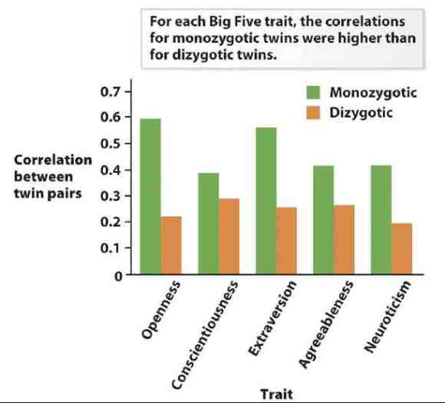
Biological Perspective
Is there a genetic component to our personalities?

Slide 32
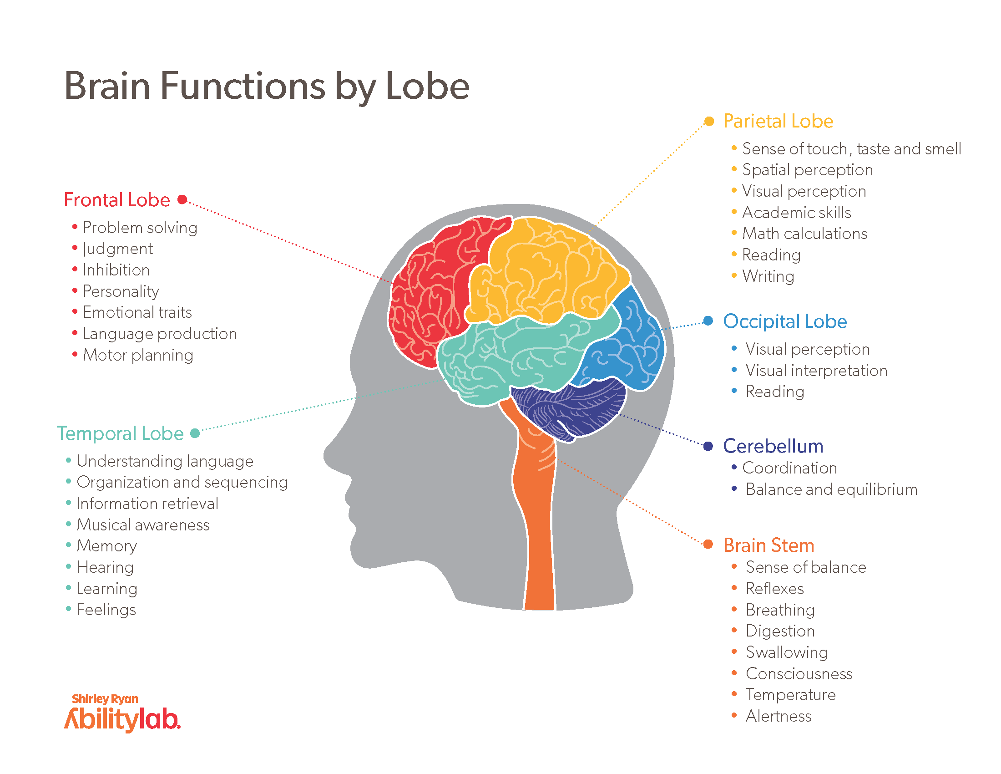

Slide 33
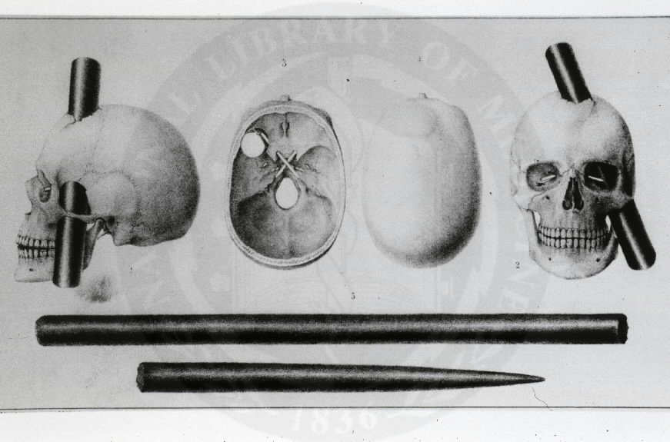

Slide 34
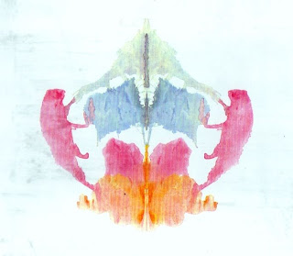
Projective Measures
Rorschach inkblots
Not commonly used
Little evidence that it is valid and reliable

Slide 35
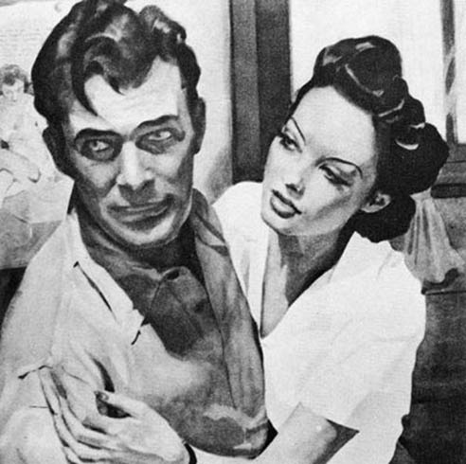
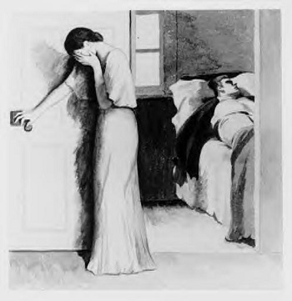
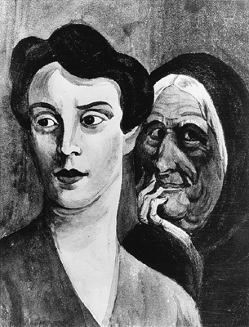
Projective Measures
Thematic Apperception Test (TAT) or Picture Story Exercise (PSE)
Series of ambiguous pictures viewed one at a time
elicited stories reveal an individual’s personality
In contrast to Rorschach test does have reliability and validity
Can code stories for motivation, needs for power, achievement, intimacy, etc

Slide 36
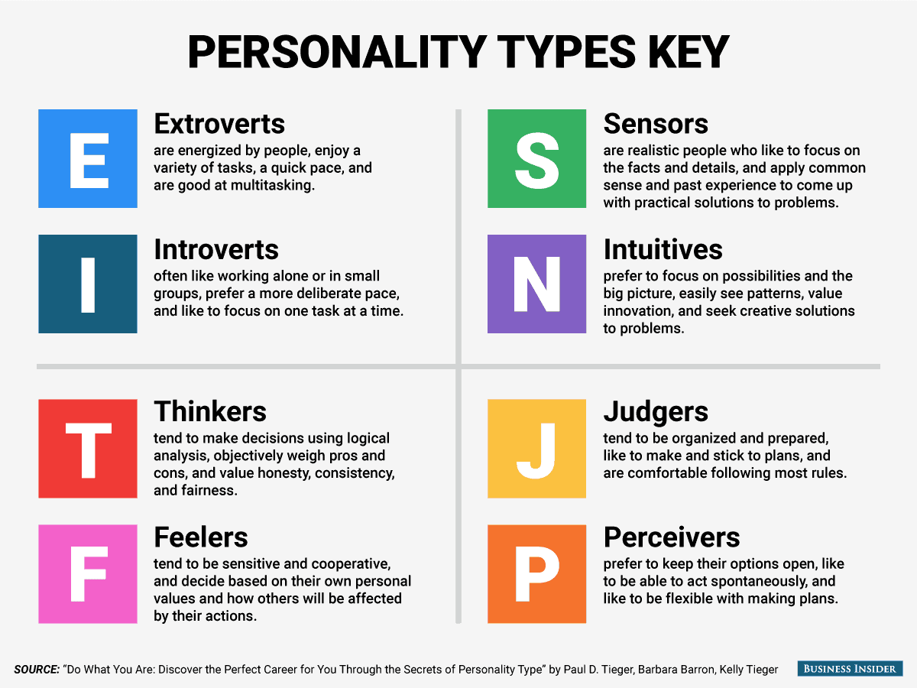
Self-Report Measures
Myers-Briggs Personalities Test

Slide 37
Better Self-Report Measures
Minnesota Multiphasic Personality Inventory (MMPI)
Shown to be reliable and valid
Most commonly used
Clinical Settings
Hiring Decisions
Forensic settings
Neuroticism Extroversion Openness Personality Inventory-Revised (NEO-PIR)
Known for measuring and testing the 5 factor model
OCEAN
Shown to be valid and reliable

Slide 38
Questions?

